Slide 1
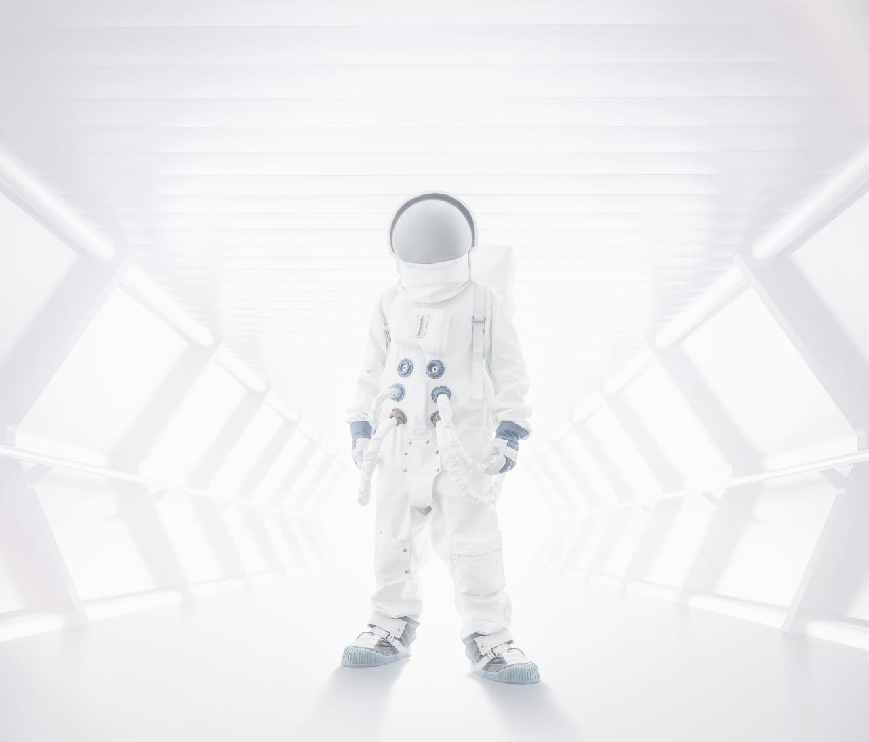
AI & Data Science
Swami Keshvanand Institute of Technology, Management & Gramothan, Jaipur
Industrial Training Presentation
Department of Electronics and
Communication
Engineering
Presented to :
Mr. Abhinandan Jain,
Asst. Professor, ECE, SKIT
Mrs. Suman Sharma,
Asst. Professor, ECE, SKIT
Presented By:
Shubham Udsaria
18ESKEC073
7ECA-G3
Date of Presentation: 10 Sep. 2021

Slide 2


Table of Content
About Course
Purpose of course
Description of course
Introduction
Artificial Intelligence
Data Science
Artificial Intelligence
Data Science
Project Work
Summary
Outcomes
Certificates
Greeting

Slide 3
Artificial Intelligence
Data Science
Duration : 4 weeks
Platform : Edx
Hardness : Beginner level
Offered by : IBM
https://learning.edx.org/course/course-v1:IBM+AI0101EN+2T2021/home
Duration : 6 weeks
Platform : Edx
Hardness : Beginner level
Offered by : IBM
https://learning.edx.org/course/course-v1:IBM+DS0101EN+2T2021/home

Slide 4

Course Purpose
Define Artificial Intelligence.
Describe examples, applications, and impact of AI.
Implementation of AI in real life.
Define Data Science.
Learn some key fundamentals in the field of data science.
Using data to ease the work.

Slide 5

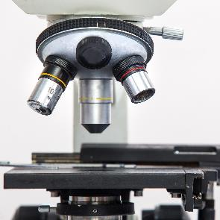
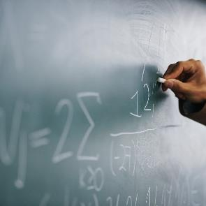
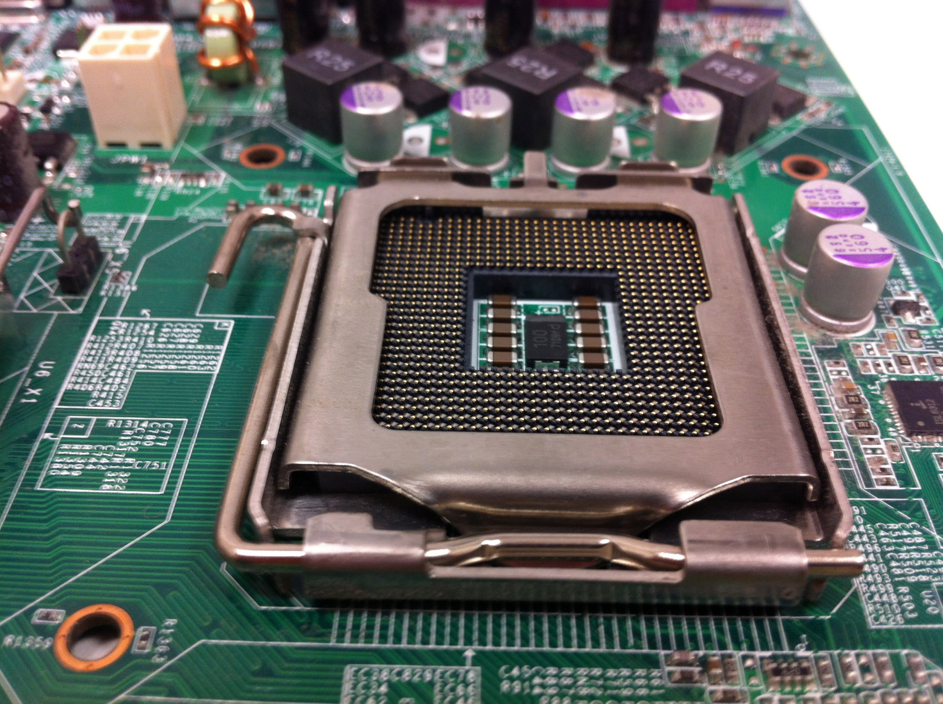
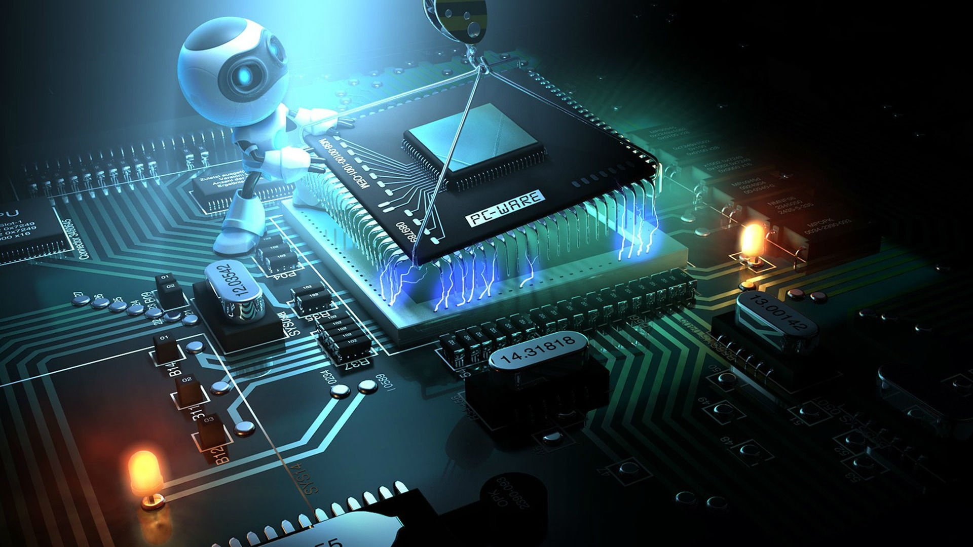
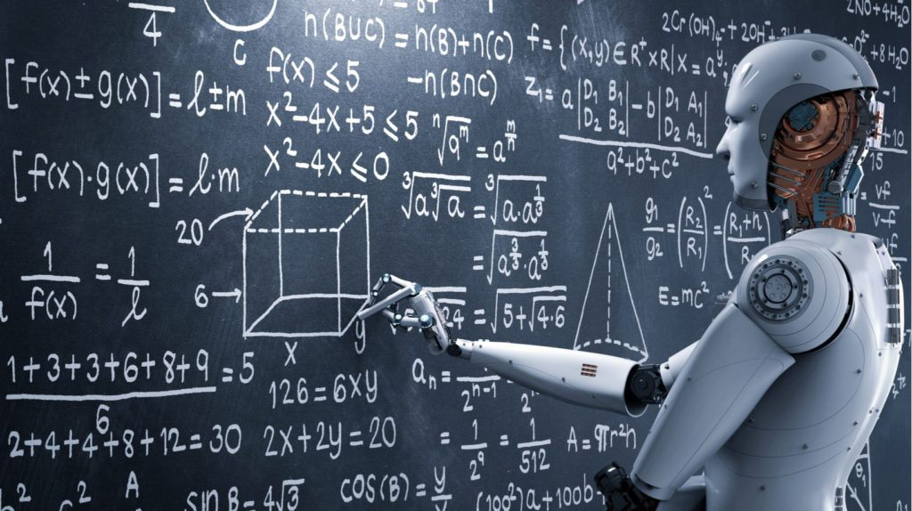
Introduction
Artificial Intelligence
Intelligence demonstrated by the Machines in contrast to Natural Intelligence delivered by Humans.
Intelligence is given by feeding the experience of human to machines in the form of data.
“AI WILL BE THE BEST OR WORST THING EVER FOR HUMANITY.” – Elon Musk
1
2
3
4
5
6

Slide 6
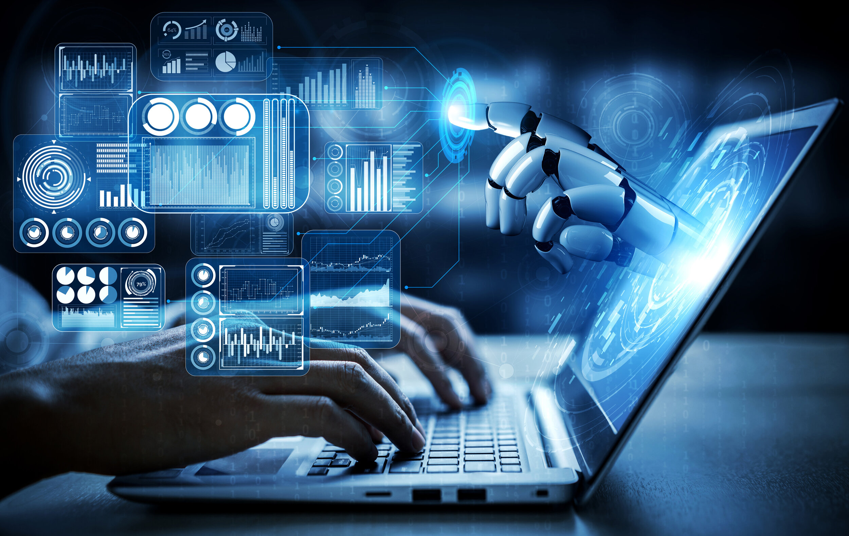
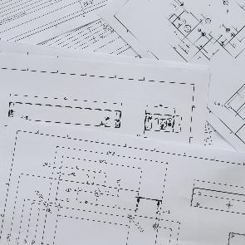
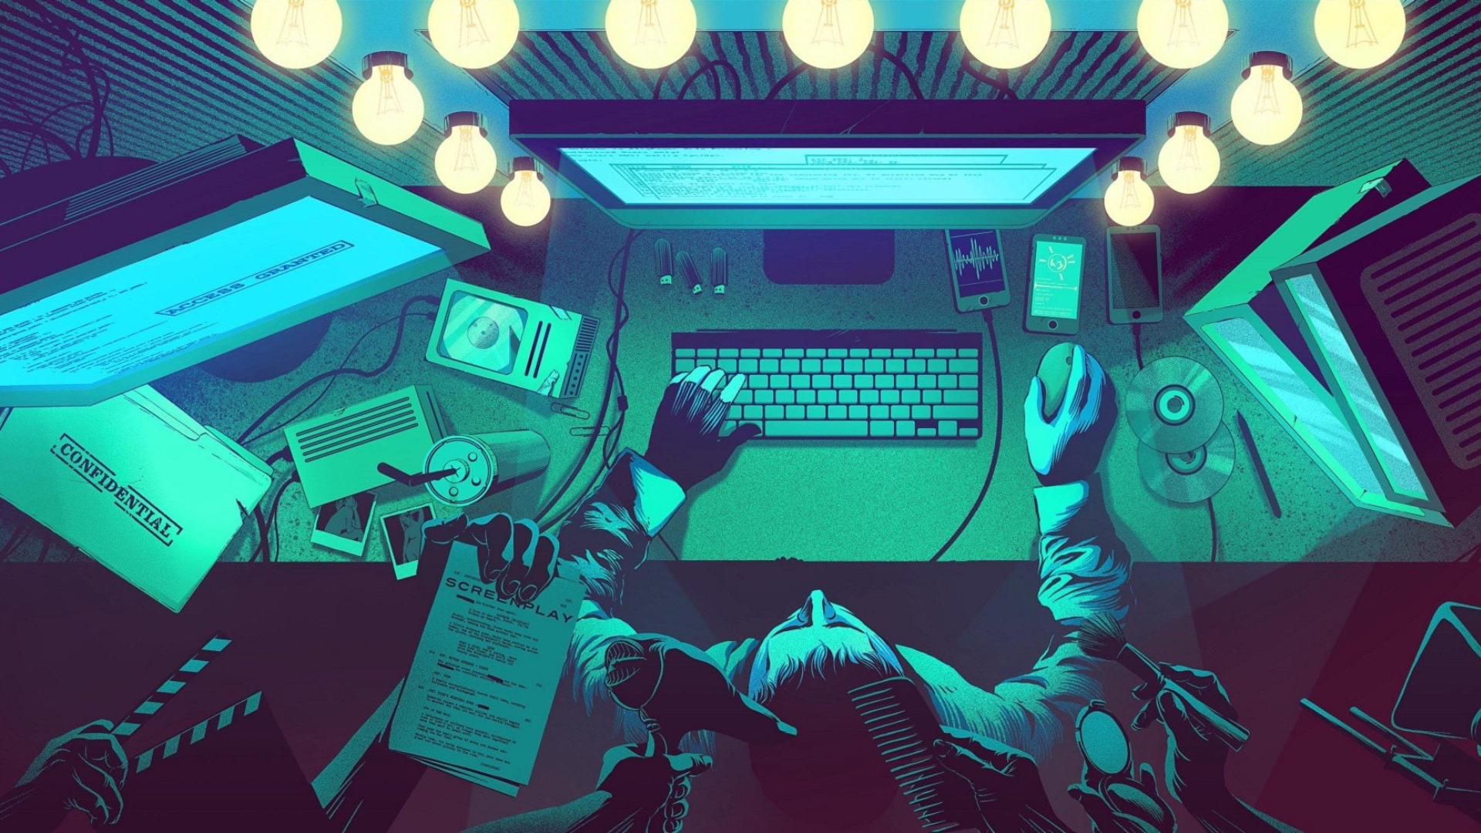
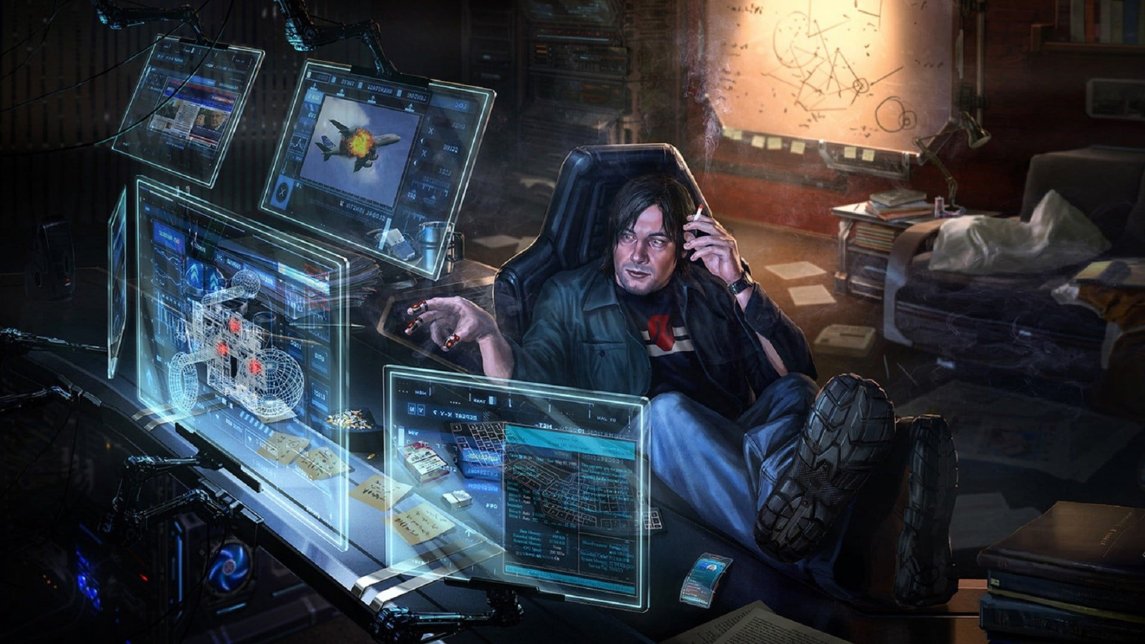
Introduction
Data Science
Data science is an interdisciplinary field that uses scientific methods, processes, algorithms and systems to extract knowledge and insights.
Uses noisy, structured and unstructured data, and apply knowledge.
“Without big data analytics, companies are blind and deaf, wandering out onto the web like deer on a freeway.” – By Geoffrey Moore
1
2
3
4
5
6

Slide 7
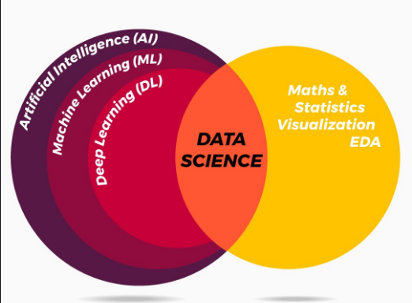
Comparison

Slide 8
Applications of AI and Data Science
Artificial Intelligence
Robotics
Outer Space Exploration
Customer Service
Stock Market and Finance
Automated Cars
Healthcare Industry
Data Science
Fraud and Risk Detection
Website Recommendations
Gaming
Targeted Advertising

Slide 9
Machine Learning
Human’s knowledge is only obtained by the experience throughout their life. For machines those knowledge is need to be fed, by collecting enormous amount of data on a certain application and fed to it, machines also obtains the knowledge in short period of time.
There are three types of Machine Learning
Supervised
Unsupervised
Reinforcement

Slide 10
Deep Learning
Recognition
Brain
Vision
Training
Dataset
Model
Recognition

Slide 11
Computer Vision
Early experiments in computer vision took place in the 1950s, using some of the first neural networks to detect the edges of an object and to sort simple objects into categories like circles and squares.
Computer vision is an interdisciplinary scientific field that deals with how computers can gain high-level understanding from digital images or videos.
Image processing, an image is "processed", transformations are applied to an input image to get output image.
Computer vision, an image or a video is taken as input, and the goal is to understand the image and its contents which uses image processing algorithms to solve some of its tasks like human brain

Slide 12
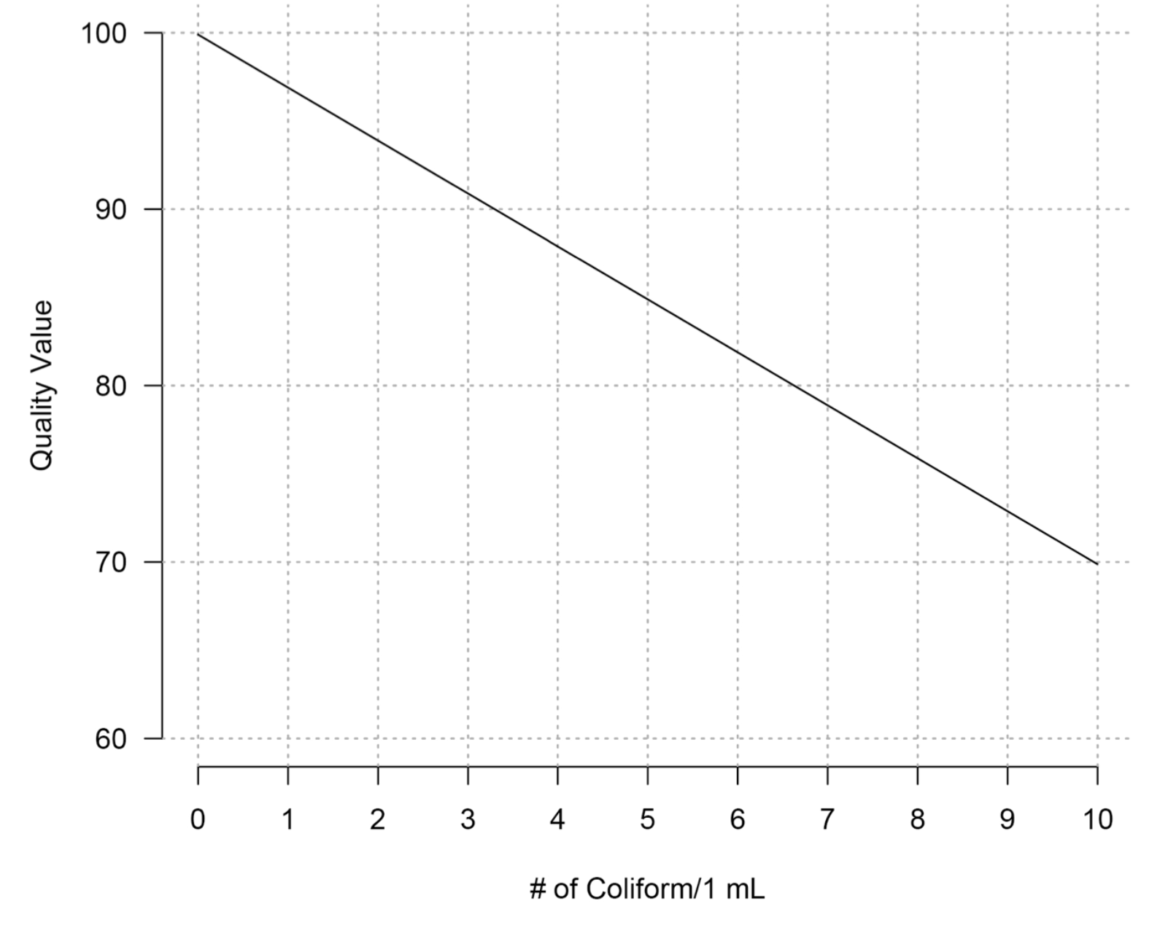
Data Science with example
Year | Mean Annual Temperature (˚C) | Mean Annual Humidity (%)
2010 | 20 | 60
2011 | 21 | 56
2012 | 20 | 59
2013 | 18 | 65
2014 | 20 | 58
2015 | 22 | 54

Slide 13
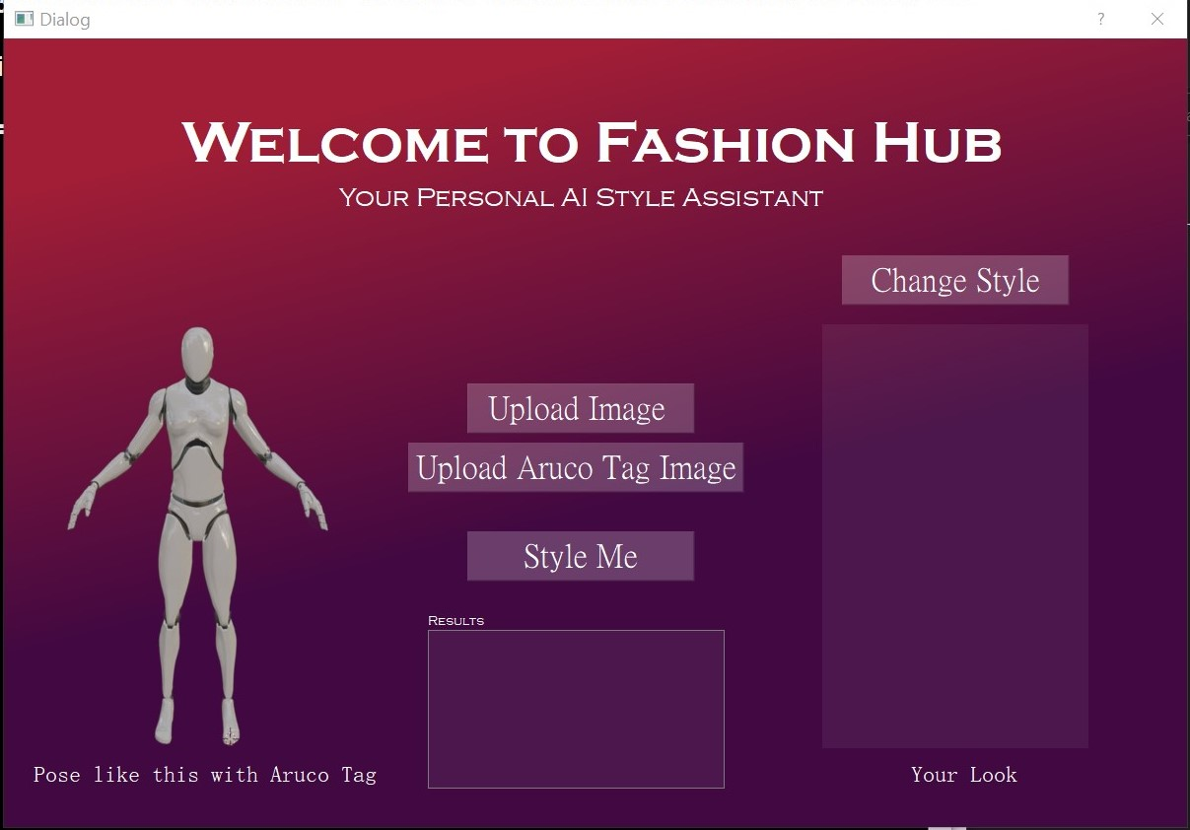
Project Work
Project: It’s a simple UI based application that is used to dress you up. Something like Lenskart.
Why I got this idea?
Application of this Project

Slide 14
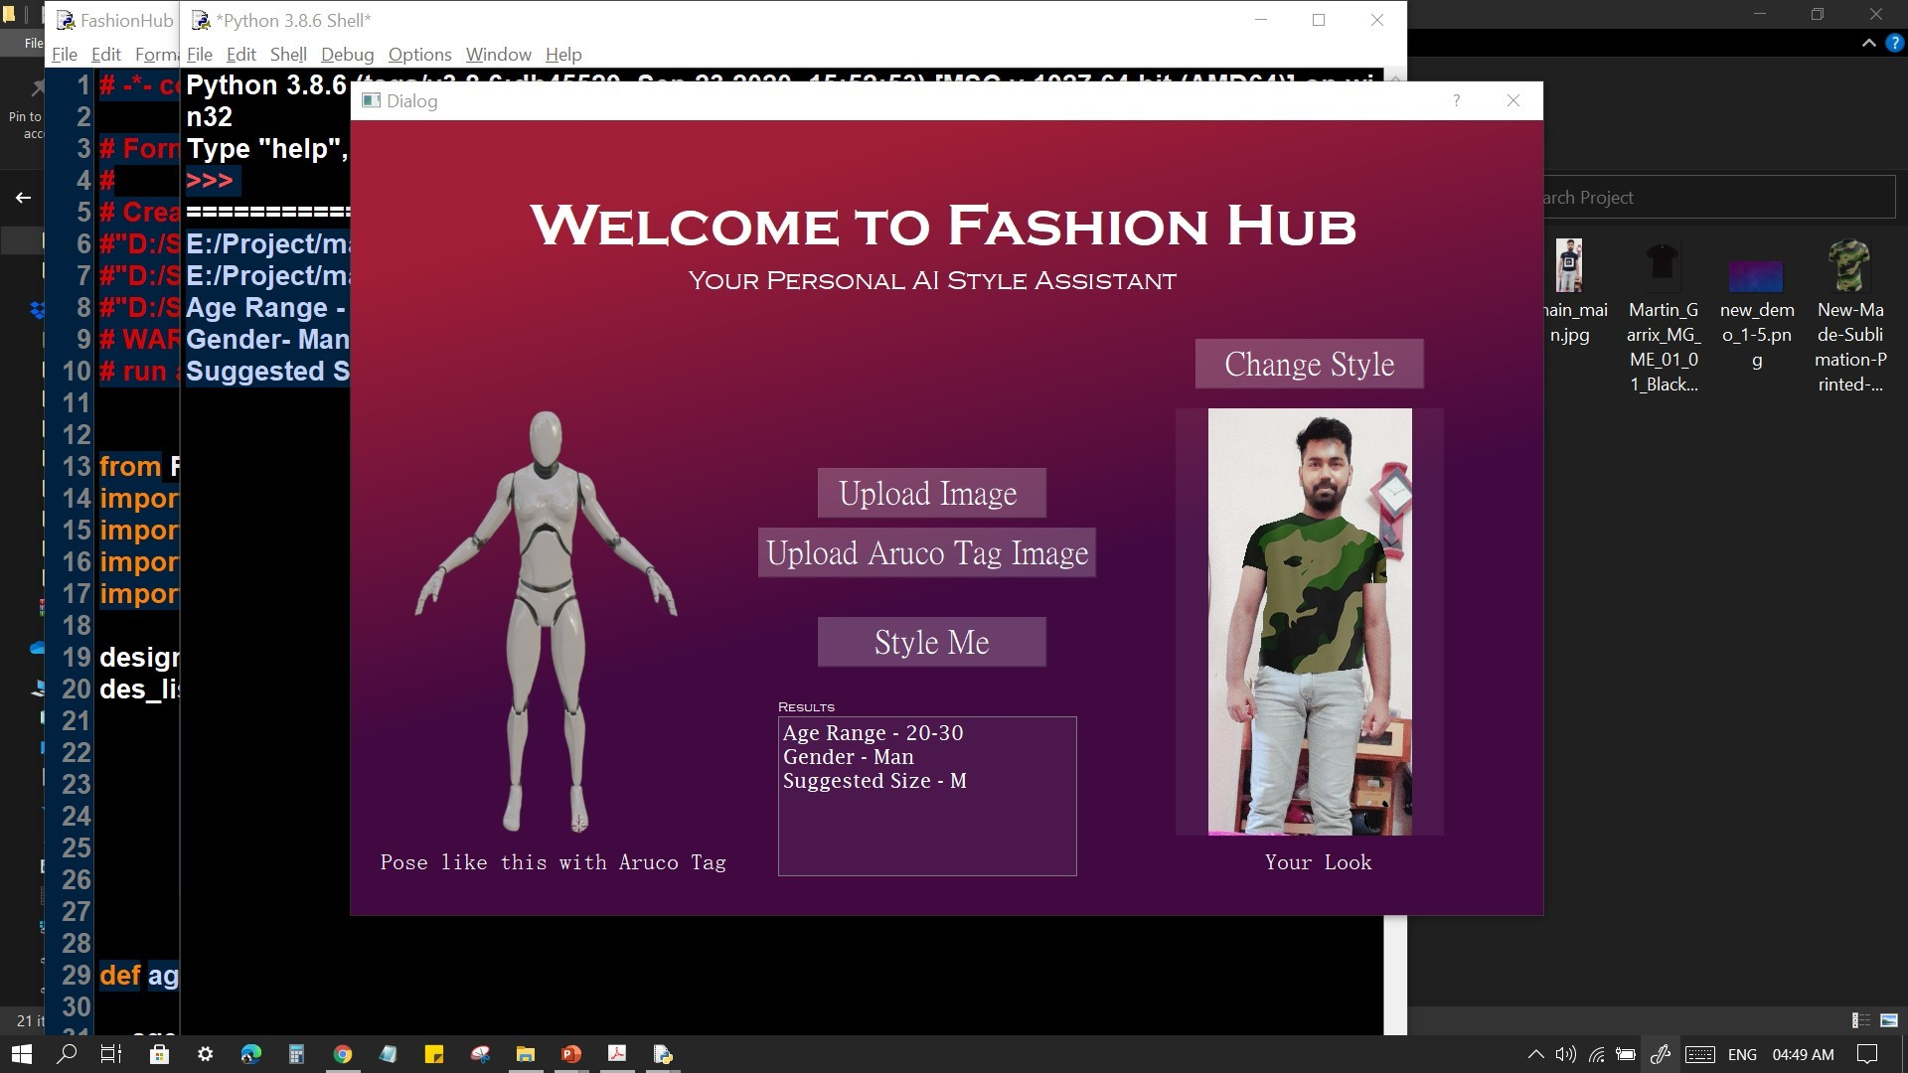
Technologies Used
Deep Learning and Machine Learning Models
Language: Python
Computer Vision
Green Screen
Libraries:
OpenCV
Numpy
Math
Aruco
PyQt5

Slide 15
Working
UI based on PyQt is popup as dialog box
Takes 2 images as Input. First one: Green image, Second one: Aruco tag image
Then tell us about your age range, gender, cloth size and style you with your favaroite dress.
Sample Code:
Age and Gender:
age_model=cv2.dnn.readNetFromCaffe("age.prototxt","dex_chalearn_iccv2015.caffemodel")
gender_model = cv2.dnn.readNetFromCaffe("gender.prototxt", "gender.caffemodel”)
age_model.setInput(img_blob)
age_dist = age_model.forward()[0]
gender_model.setInput(img_blob)
gender_class = gender_model.forward()[0]
output_indexes = np.array([i for i in range(0, 101)])
apparent_predictions = round(np.sum(age_dist * output_indexes), 2)
gender = 'Woman ' if np.argmax(gender_class) == 0 else 'Man'

Slide 16
Working
Sample Code:
Measurements:
MODE == "MPI":
protoFile = "pose_deploy_linevec_faster_4_stages.prototxt"
weightsFile = "pose_iter_160000.caffemodel"
nPoints = 15
POSE_PAIRS = [[0, 1], [1, 2], [2, 3], [3, 4], [1, 5], [5, 6], [6, 7], [1, 14], [14, 8], [8, 9], [9, 10],
[14, 11], [11, 12], [12, 13]]
frame = cv2.imread(img)
frameCopy = np.copy(frame)
frameWidth = frame.shape[1]
frameHeight = frame.shape[0]
threshold = 0.1
net = cv2.dnn.readNetFromCaffe(protoFile, weightsFile)
net.setPreferableBackend(cv2.dnn.DNN_TARGET_CPU)
Live Demo

Slide 17
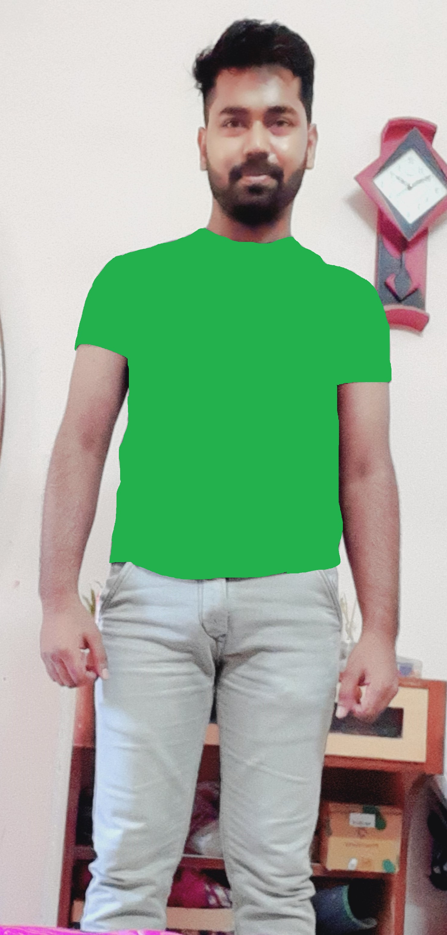
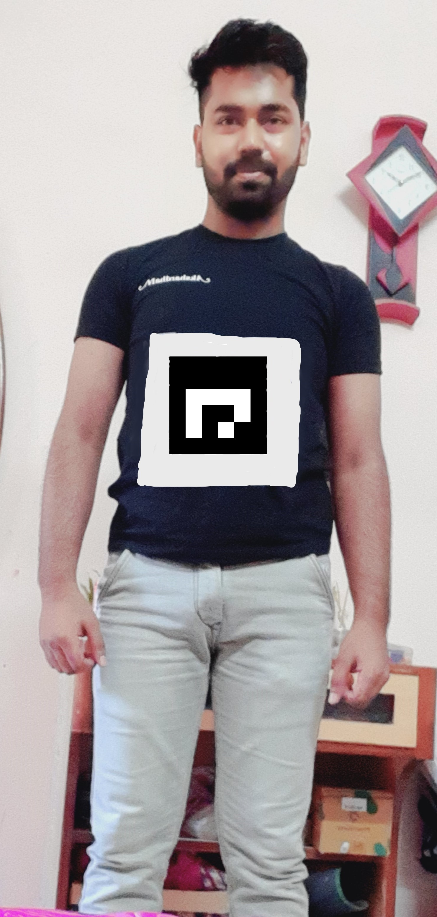
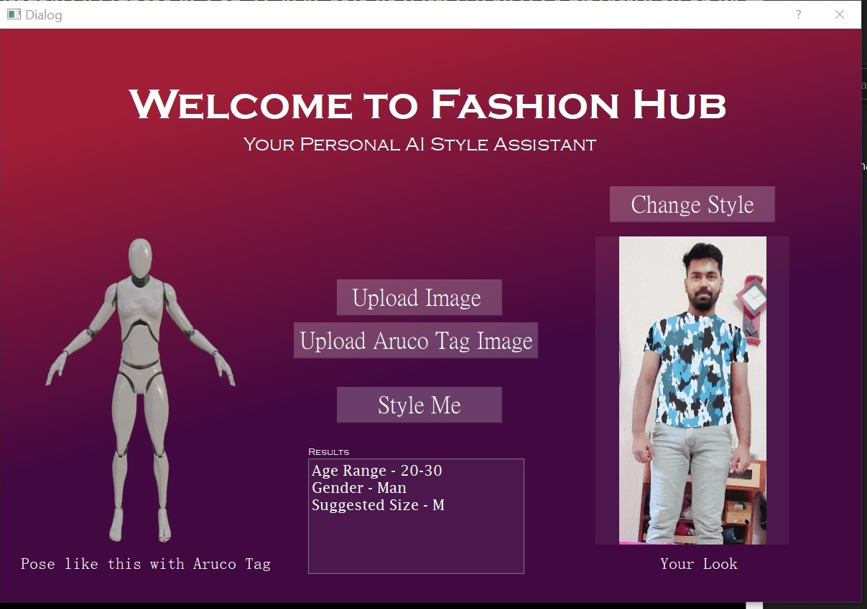
Input/Output
Green Image, 2. Aruco tag Image
3. Output Image

Slide 18
Future Work
More number of Dresses.
Using only one pic as input
Better UI
More predictions like Ethinicity, recommandance according to their past choices.
Integration with Cloud.

Slide 19
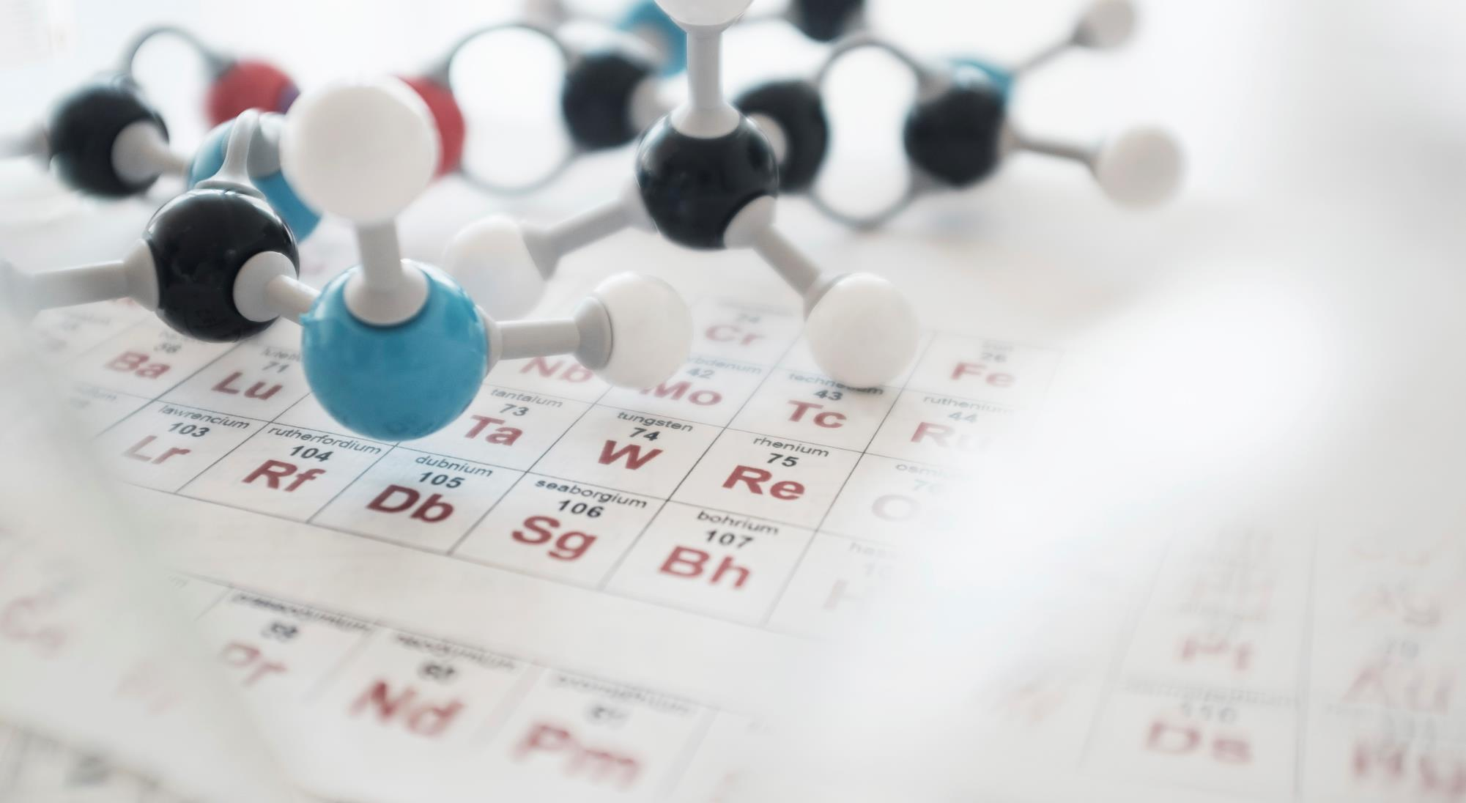
Summary
Course Outcome
Learnt basics of AI and Data Science.
Learnt about new technologies like Machine Learning, Deep Learning, Computer Vision etc.
Done some hand on projects related to these technology and use them in real life.
Learnt how data gathered, separated and filtering out useful features from data.
Artificial Intelligence is our new future. In up coming days all things will be working on their own intelligence.
Data Science is something that powers the AI. There will be no existence of AI without DS.

Slide 20
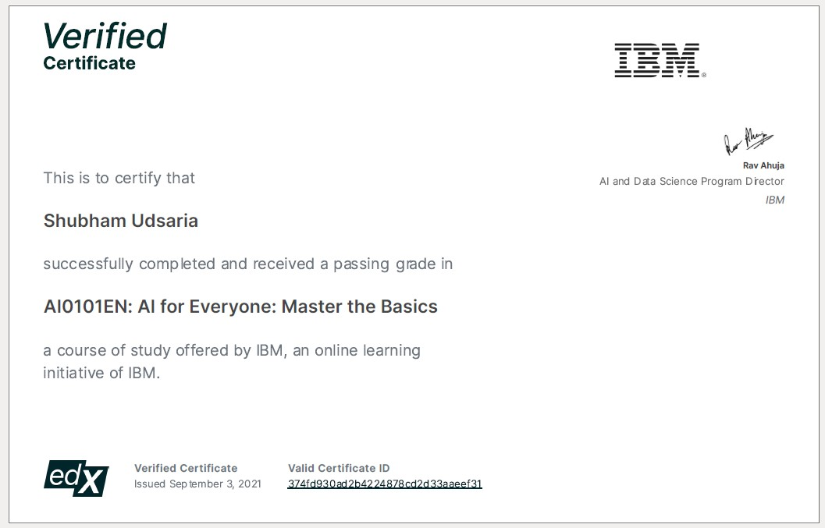
Video slide
AI Certificate : 374fd930ad2b4224878cd2d33aaeef31

Slide 21
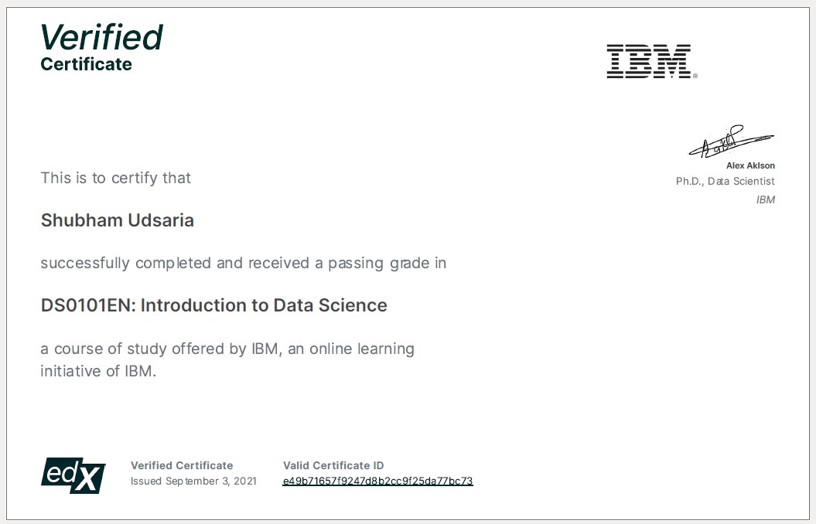
Video slide
DS Certificate : e49b71657f9247d8b2cc9f25da77bc73

Slide 22


Thank You
Shubham Udsaria
sudsaria94@gmail.com
linkedin.com/in/shubhamudsaria

